Slide 1
Collaborative Platform Version 5.0
Team Members
Product Owner
Adrian Alfonso
Juan Caraballo
Jorge Travieso

Slide 2
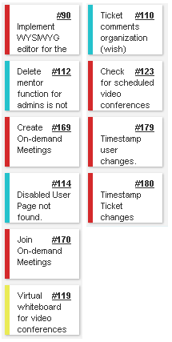
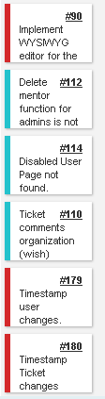
Sprint 2 Stories
My Sprint 2 Stories
Done and approved
Done and approved
Done and approved
Done and approved
Total 76 pts
Done and approved
Total 40pts
Done and approved

Slide 3
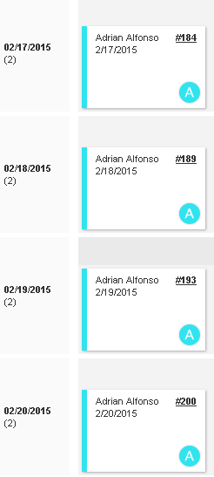
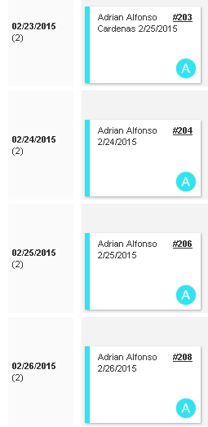
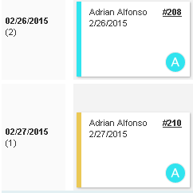
Daily Scrums

Slide 4
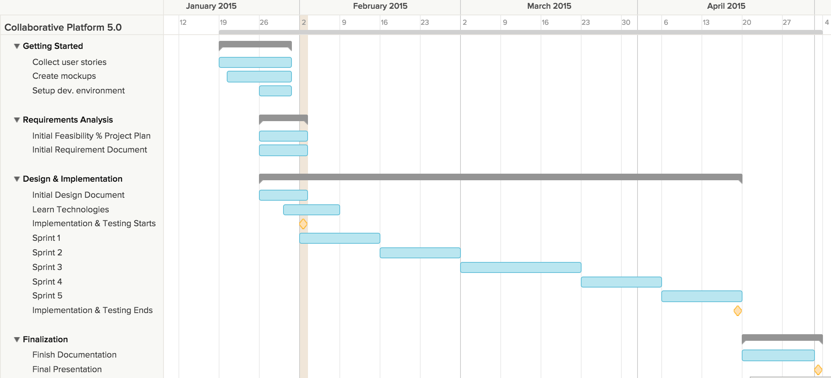
Project plan

Slide 5
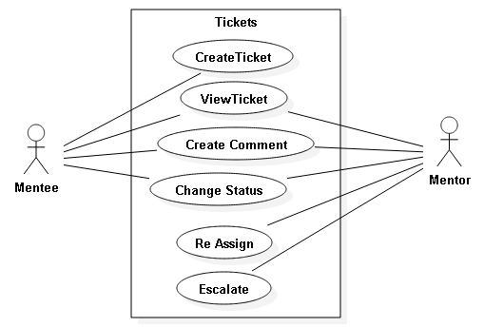
Use Cases Modified

Slide 6
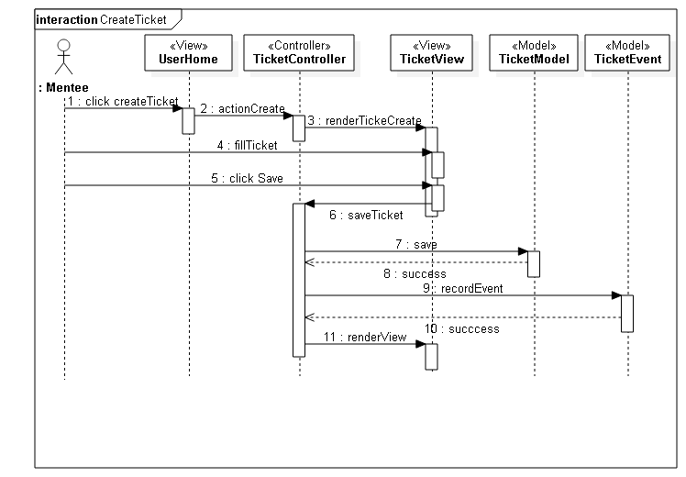
Sequence Diagram (Create Ticket)

Slide 7
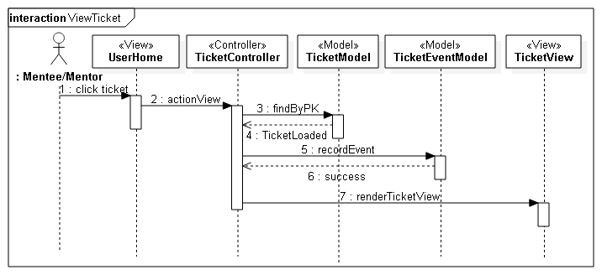
Sequence Diagram (View Ticket)

Slide 8
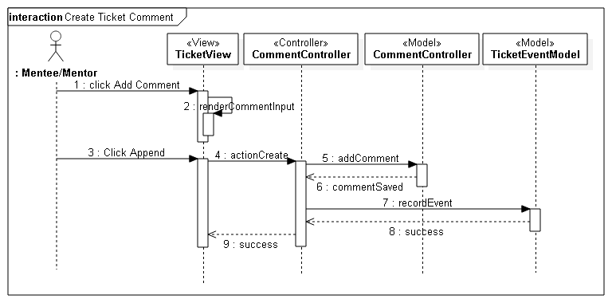
Sequence Diagram (Create Comment)

Slide 9
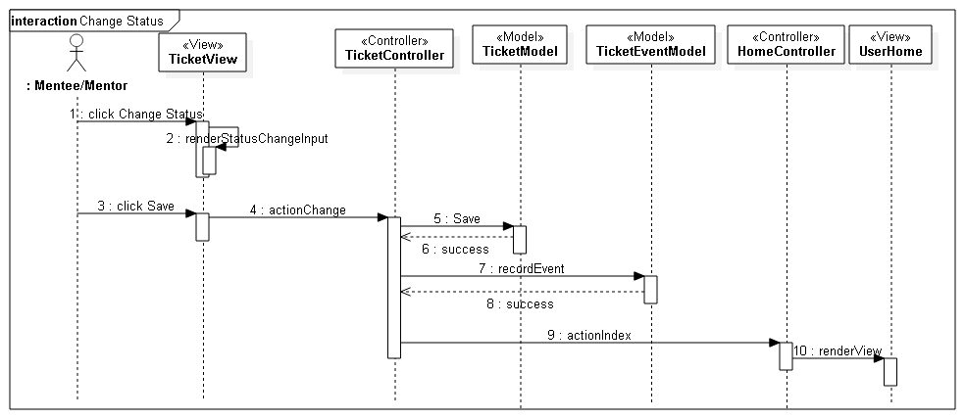
Sequence Diagram (Change Status)

Slide 10
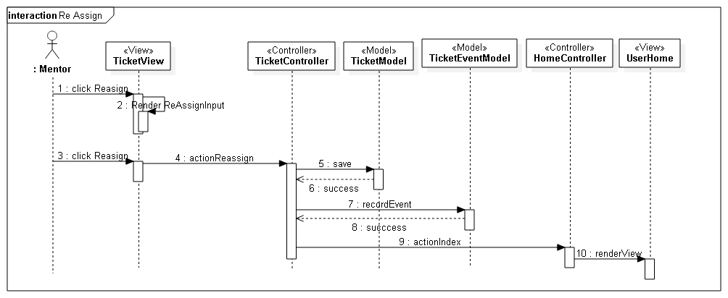
Sequence Diagram (Re Assign)

Slide 11
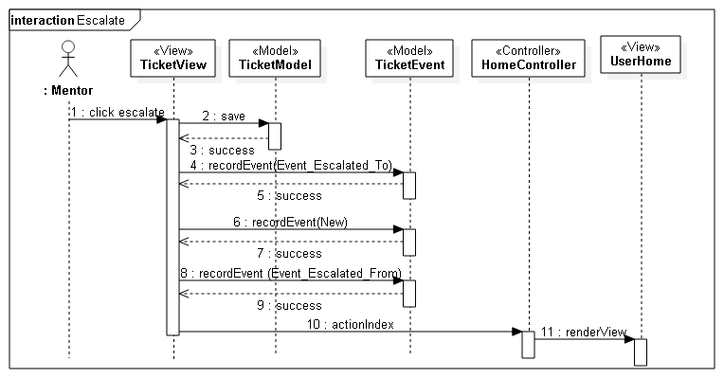
Sequence Diagram (Escalate)

Slide 12
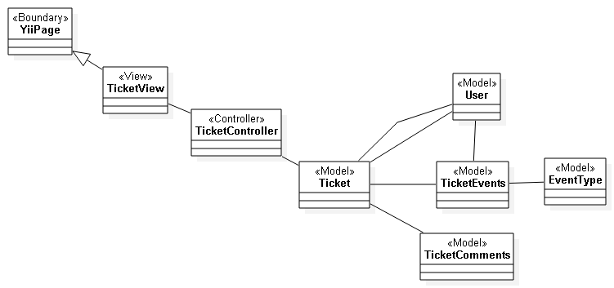
Class Diagram (Ticket Events)

Slide 13
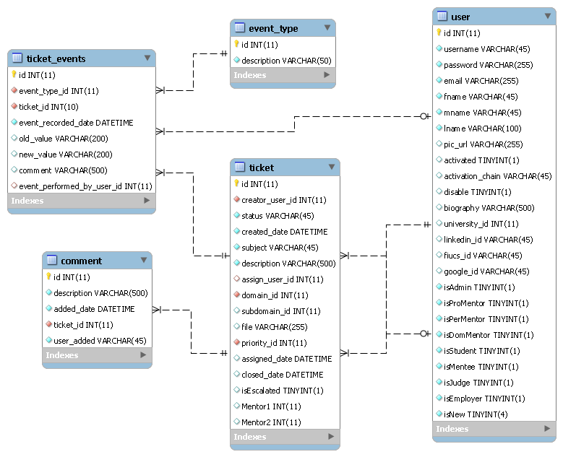
ER Diagram

Slide 14
Burndown chart

Slide 15
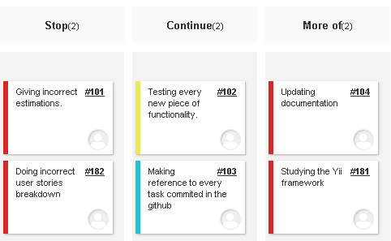
Retrospective

Slide 16
Sprint 3 Stories
My Sprint 3 Stories
Total ?? pts
Total ?? pts

